Slide 1
Finance Transformation, November 2019
Daniel Willoughby

Slide 2




Key Objectives

Slide 3
Coca-Cola European Partners

Slide 4
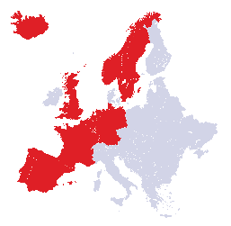
We work in partnership with The Coca-Cola Company
Consumer
focus
B2B
Customer
focus
Brand ownership,
product development
and innovation;
brand marketing
and advertising
Bottling and
distribution, customer
marketing, market
execution and
innovation
200
130,600
13
23,500
countries worldwide
employees
countries
employees
2

Slide 5

Our Finance Leadership Team, which leads ~1,300 associates across 13 countries
Nik Jhangiani
Chief Financial Officer
Corporate Finance
Corporate Audit
Shared Services
Procurement
Business Partners
Ed Walker
Financial Planning & Analysis
Torsten Hoppe
Tamsin Hoborough
Ralf Peters
Marcus Rohde
Germany BU
Scott Bourgeois
Financial Controller
Albert Perez
Iberia BU
Rogier Rolink
Tax
T.J. Wolfe
Great Britain BU
Sarah Willett
Investor Relations
Florian Tornow
France BU
Cigdem Gures Erden
Treasury
Frits van Zijdervelt
Northern Europe BU
Mike Clark
Enterprise Performance Reporting

Slide 6
Our “Finance Service Delivery” Model sets the foundation for our transformation roadmap
LOW LEVEL OF
BUSINESS PROXIMITY REQUIRED
HIGH LEVEL OF
BUSINESS PROXIMITY REQUIRED
Business Performance
activities
Centre of Expertise
Local Planning & Performance Management activities
BU & Supply Chain
Transactional & Compliance activities
Central Planning & Performance Management activities
Shared Services Centre
Group
PPM
Technical Finance & Governance activities
Global Finance Functions
We believe this delivery model will allow us to achieve world class levels of efficiency and effectiveness, while supporting our growth ambitions

Slide 7
Finance Transformation

Slide 8


Slide 9







Finance Transformation Journey 2007 to 2019
2015/16
2016/19
2014/15
2013
The Future
2012/13
2011
PPM Transformation
PPM Transformation utilizing CoE and enhancing insight and business partnering
Creation of CCEP & Integration
Bringing together the 3 Bottlers (Day1)
CCEP Tableau reporting
Germany and Iberia transition to SSC
Supply Chain Finance transition to CoE
SSC 2.0
SSC2.0- leverage SSC to further improve effectiveness and efficiency
2010
Creation of CCIP
Formation across local bottlers to create a new Iberia Finance function
SSC created to service all Spanish Companies and Reporting Factory
Finance Transition
Set-up of SSC in Sofia, Bulgaria - focusing in-country finance teams away from transactional responsibility
PPM – Business Partnering & RGM Focus implementation of BPC
2007/9
New Finance Vision
Post transaction, position the longer term objectives of Finance. OCM Focus
Germany SSC
Creation of the Berlin Hohenschönhausen
Moving the finance teams from the sales centres.
Finance Optimization
Global service delivery model set up, migrating processes to Tampa and CG

Slide 10
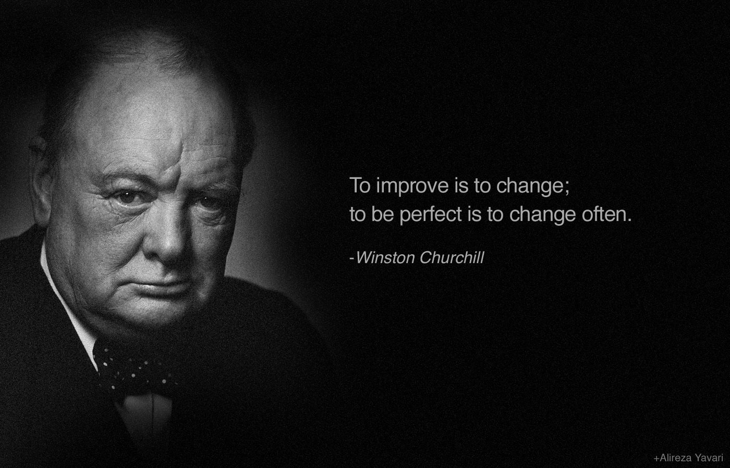

Slide 11
The Future of Finance

Slide 12




Impact of Disruption and Change

Slide 13
Cloud
Predictive Analytics
Robotics
Artificial Intelligence / Machine Learning
Customer Experience
SAP S/4Hana
Digital

Slide 14
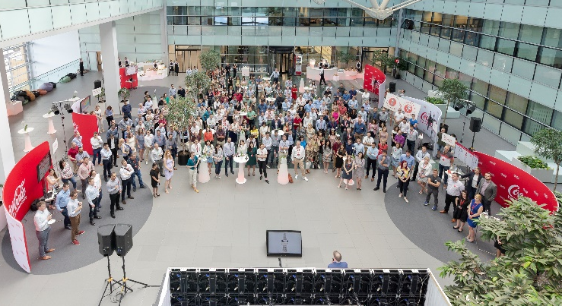
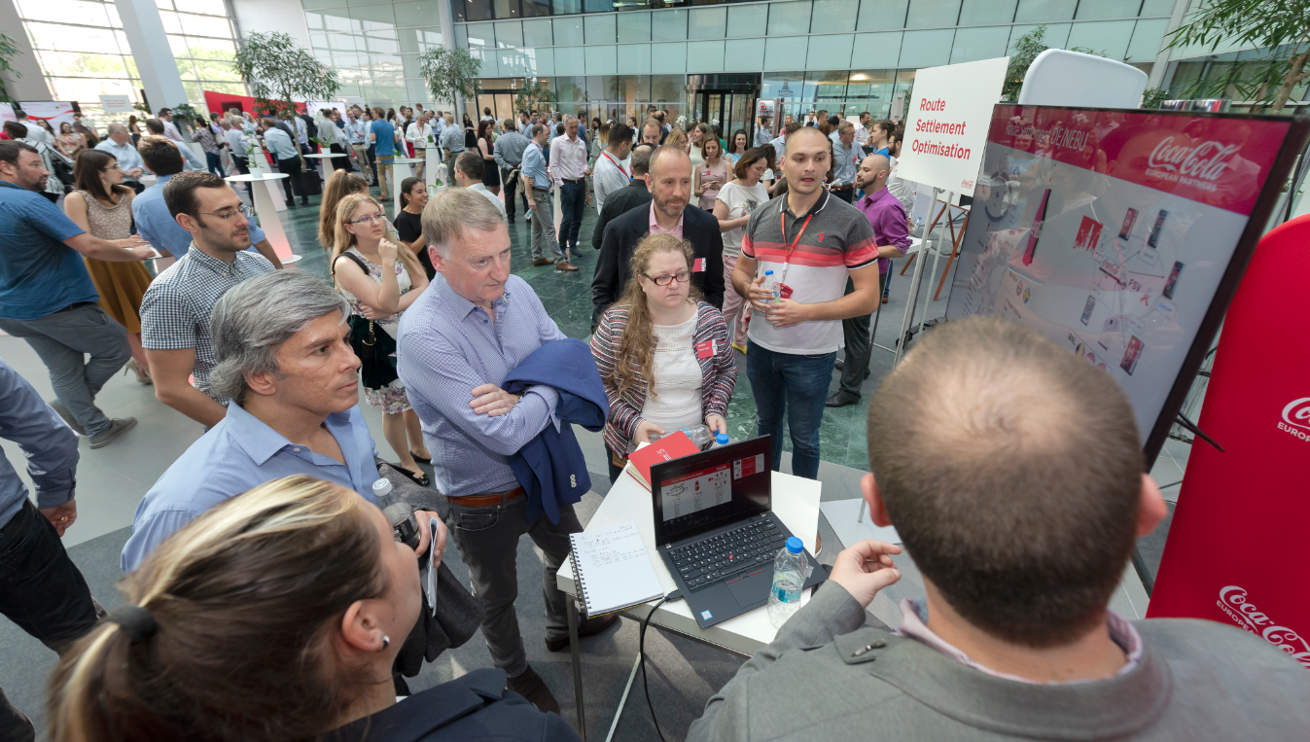

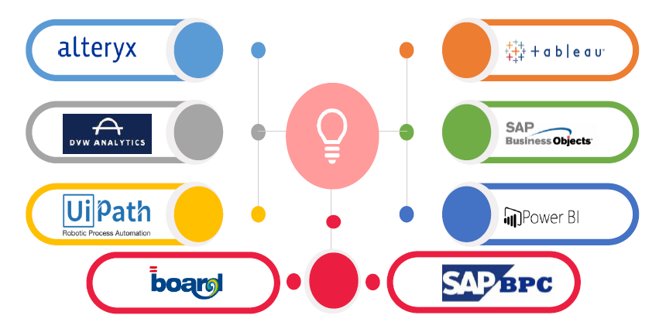
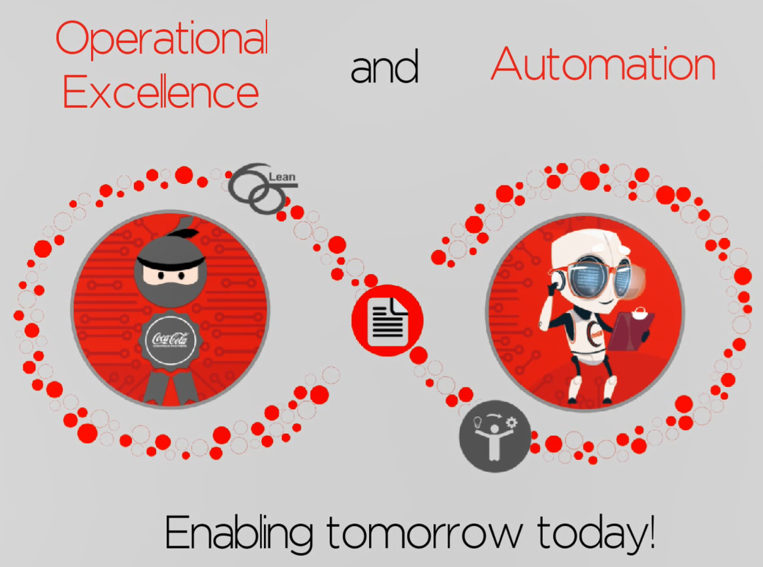
Leverage & scale our capabilities in Bulgaria
Sofia SSC & CoE capabilities showcased
Implementing best in class tool (SAP Concur) to optimise T&E process
Fast close and journal entry optimisation
Route settlement optimisation enabled by in-country use of handheld & iPhone app technology
Delivering business insights through reporting and analytics capabilities (CoE)
Combining Operational Excellence and Automation. Meet our Ninjas & Robots
>400 employees trained on Lean Six Sigma
>100 activities already automated through Virtual Employees

Slide 15
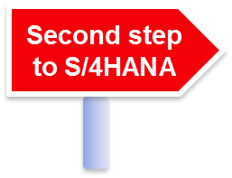

Our Central Finance & BPC journey will enable a step-change in capabilities and further unlock value
Greater internal control with fewer data sets to support standardisation
Jan 2021
Extended Planning** Supply Chain Finance):
Go-live
April 2020
Financial Consolidation and external reporting:
Go-live
Standardised and harmonised financial data models to simplify processes
June 2019
Financial and Management Reporting: Process and functional design
March 2019
Financial Consolidation: Process and functional design
7
Unified Planning and Financial Consolidation
5
3
6
We have a long road ahead of us
CFIN & BPC starts here
1
4
June 2020
Core Planning*:
Go-live
Automate aggregation, allocations and other manual processes to remove manual effort
2
Jan 2020
Financial and Management Reporting:
Go-live
Three legacy SAP ERPs
May 2019
Core Planning* & Extended Planning**: Process and functional design
Structured workflow management to be more efficient
Consistent way of working to better support of finance professionals
Please note: *Core planning is planning related to Commercial business activities
**Extended planning is related to Supply Chain and Logistics

Slide 16
Great People

Slide 17


What is the future?

Slide 18




Diversity & Inclusion Action Plan
OUR MISSION
Create a balanced environment where everyone is enabled to be their best self, being themselves
LEADERSHIP HACKS
FLT VISIBILITY
Provide our extended Finance Leadership team with simple and effective inclusion hacks to drive awareness and improve inclusivity throughout Finance
Raise awareness of key talent with the FLT
FLT New Hire monthly agenda topic to engage new hires with the leadership team
Develop shadow FLT to experience key leadership areas
D&I AMBASSADORS
Create a network group across our Global finance teams to share best practice, align approach and build consistency
Continue to use the engagement surveys to identify gaps, and build actions
INTERNAL DEVELOPMENT
DIVERSITY
Promote BU community team events to support Finance employees to build their knowledge, experience, and explore career opportunities within a different country or team
Continue to focus on the diversity within the Finance group, including gender, age and generation.
Regular use of the dashboard to check progress and current status
FLT = Finance Leadership team

Slide 19
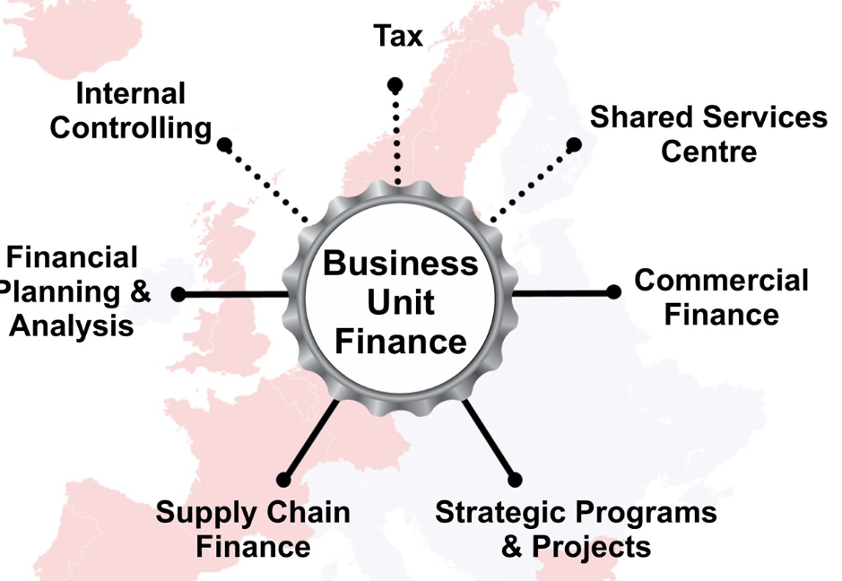
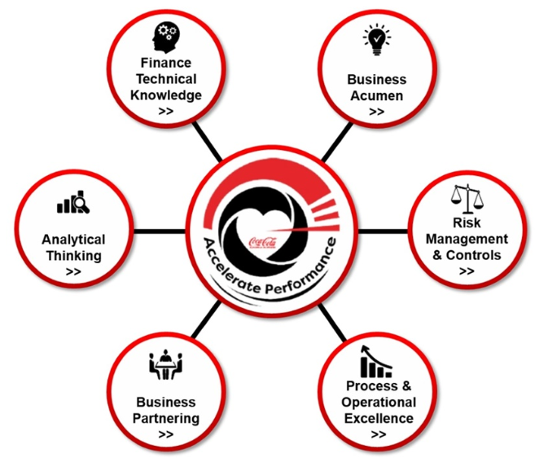
Project Compass / Career days roll-out in 2019 to support people development
Finance Competencies
Defined
and included into internal
job adverts
CCEP Finance
Finance Career
Events
Taken place in each BU
CCEP Finance
Career
Career
Toolkit
Toolkit
Finance Competencies
Finance Area Overview
Video interviews
Stakeholder maps by areas
Finance Competencies
Finance Area Overview
Video interviews
Stakeholder maps by areas
19

Slide 20
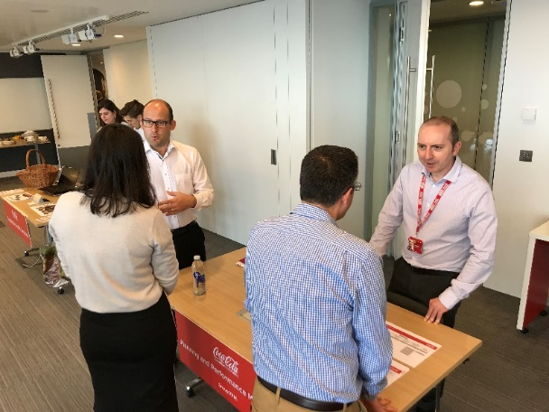
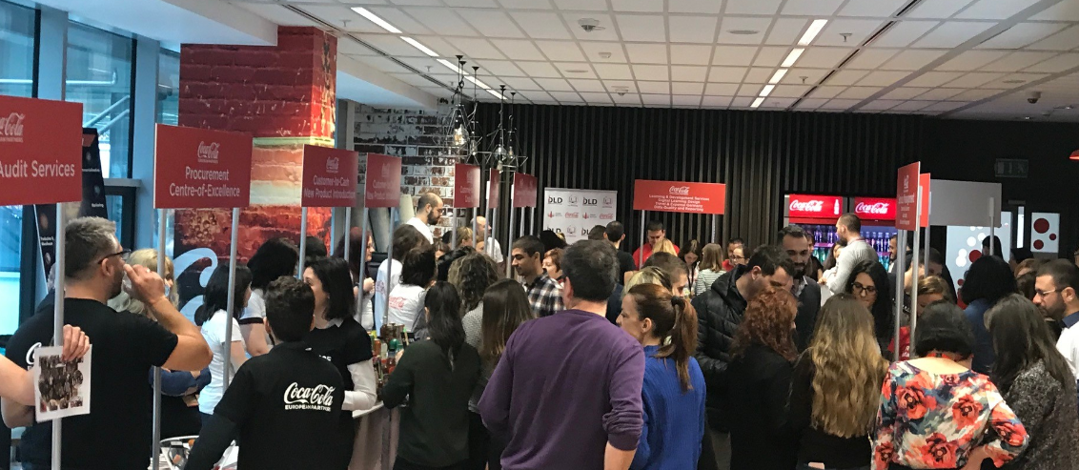
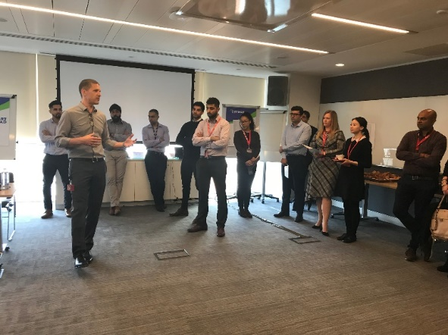
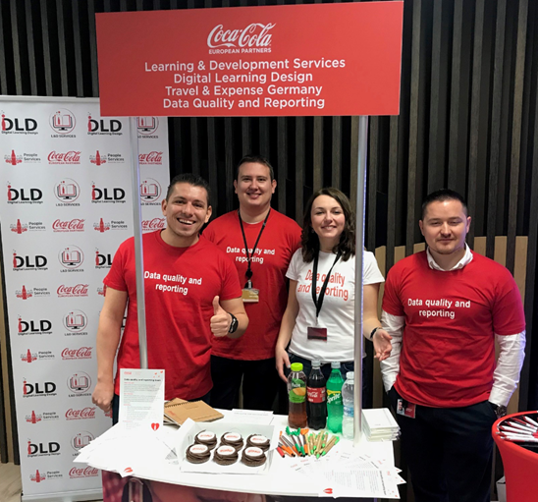
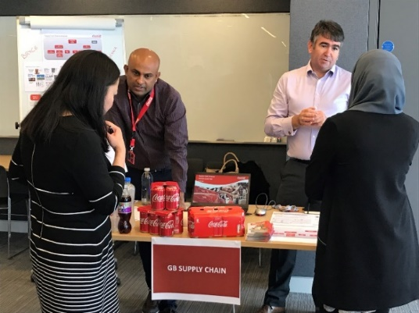
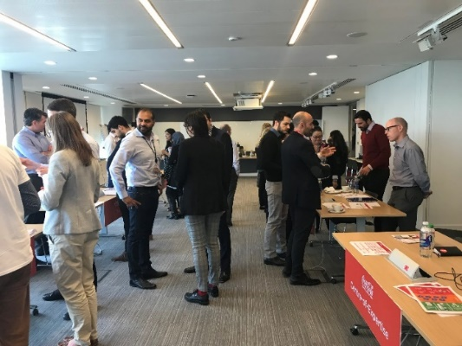
Careers Day’s in Bulgaria and GB
GB
Sofia

Slide 21
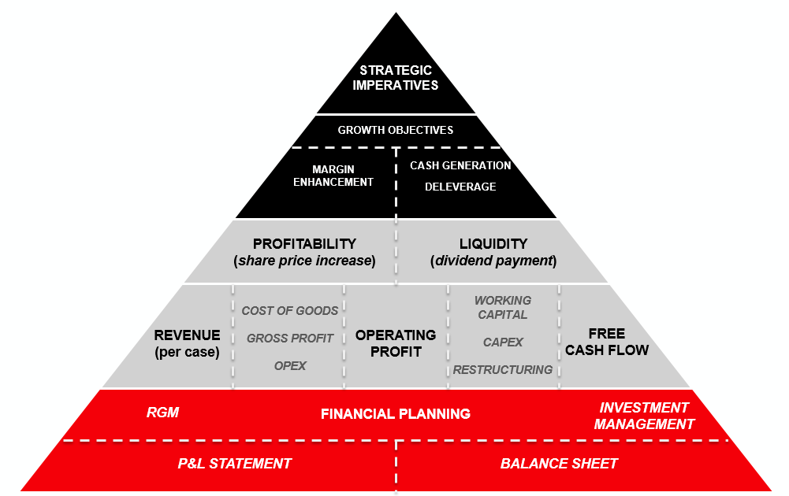
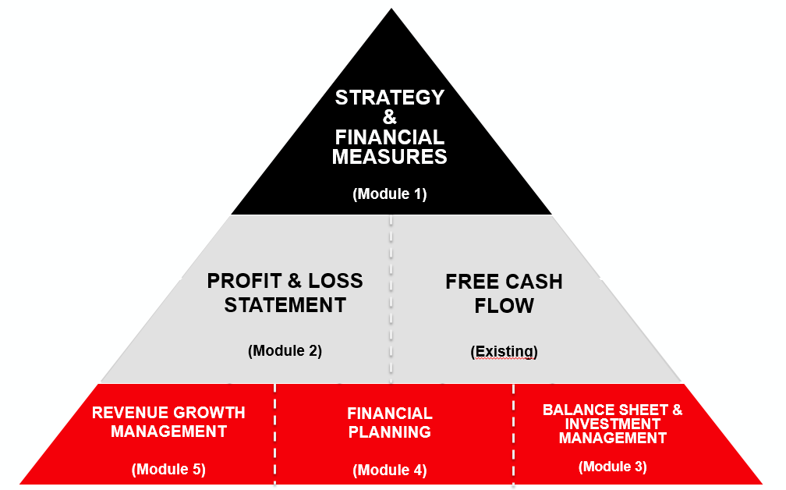
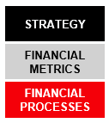
Develop ‘Finance for Non-Finance’ online modules to enhance financial acumen in business
GOAL
TO DEVELOP A FINANCE TRAINING FOR
NON-FINANCE STIP ELIGIBLE EMPLOYEES
WHY
No consistent training material available at CCEP level
Close financial knowledge gaps across the entire business
Understand how strategy & financial objectives translate into every day decision making
HOW
Multiple online training modules (±20min)
English as common language
Mgr. & Sr. Mgr.: recommended
AD & up: mandatory
Simple but engaging
Timeless
Cross-country applicable
Launched April 2019
Completed ~750
Launched Oct. 2017
Completed ~2,500
2018
2019
2020
Commence development
Launch M1
Launch M2
Launch M3
Launch M4
Launch M5
Q3
Q4
Q1
Q2
Q3
Q4
Q1
Q2
Q3
Q4

Slide 22
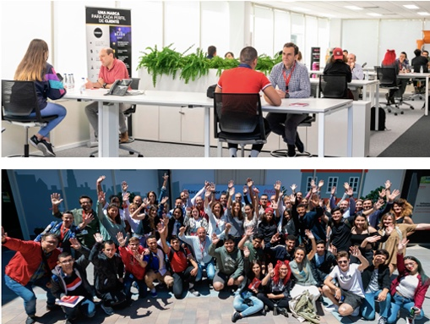
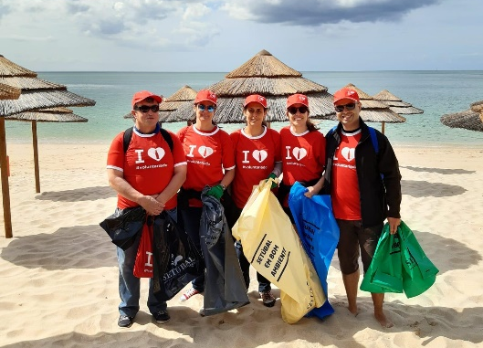
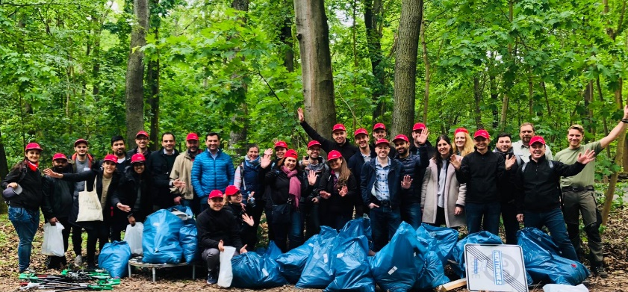



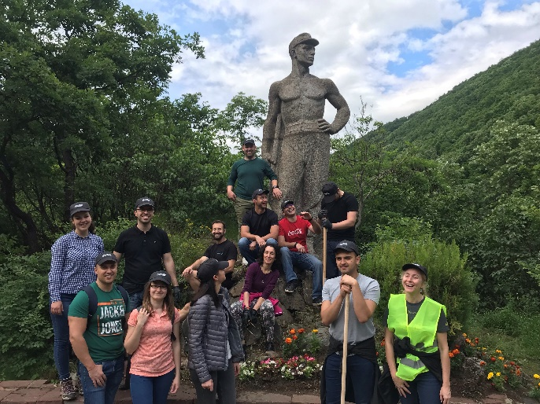

We are supporting the ‘Action on Society’ through volunteering program

Slide 23

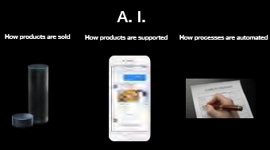

Key Take Aways

Slide 24
Daniel Willoughby, Director, Finance Strategic Initiatives
dwilloughby@ccep.com

