Slide 1
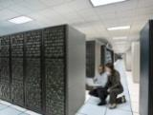
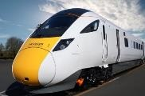
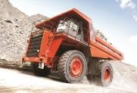
TREASURY LEADERS SUMMIT
19th November 2019
Hitachi in Europe
Guillaume de Pommereau
CFO Hitachi Europe Ltd

Slide 2
1. Overview of Hitachi
2. Introduction of European Business
3. How much should finance cost?
4. How do you use a Shared Service?
5. Which Technologies make a difference?

Slide 3
1. Overview of Hitachi
2. Introduction of European Business
3. How much should finance cost?
4. How do you use a Shared Service?
5. Which Technologies make a difference?

Slide 4
1-3. Corporate Data
Corporate Name | Hitachi, Ltd.
Founded | 1910
Headquarters | 6-6, Marunouchi 1-chome, Chiyoda-ku, Tokyo, 100-8280 Japan
Revenues | 9,480.6 billion yen (FY2018^{*1})
Adjusted operating income^{*2} | 754.9 billion yen (FY2018)
EBIT^{*3} (Earnings before interest and taxes) | 513.9billion yen (FY2018)
Net income attributable to Hitachi, Ltd. stockholders | 222.5billion yen (FY2018)
Number of consolidated employees | 295,941 (As of end of FY2018)
Number of Companies | 803 (As of end of FY2018)
*1 Fiscal Year ended 31st March, 2019.
*2 [Adjusted operating income] = [Revenues] – [Cost of sales] – [Selling, general and administrative expenses]
*3 EBIT is presented as income from continuing operations, before income taxes less interest income plus interest charges.

Slide 5
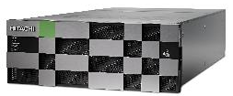

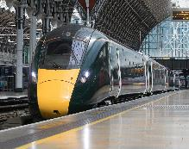
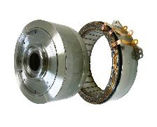
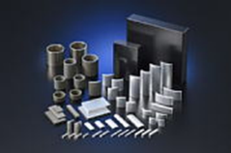

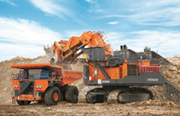
1-4. Segment Constitution (FY2018)
■Others
■Smart Life &
Ecofriendly Systems
■ Information & Telecommunication Systems
5%
5%
■Automotive Systems
20%
9%
Revenues
9,480.6 billion yen
■ Social Infrastructure & Industrial Systems
■High Functional Materials &
Components
17%
25%
10%
9%
■Electronic Systems & Equipment
■Construction Machinery

Slide 6
1-5. Global Expansion* (FY2018)
Europe
North America
■Revenues: 1,018.5 billion yen
■Number of companies: 129
■Number of employees: 17 thousand
■Revenues: 1,205.6 billion yen
■Number of companies: 88
■Number of employees: 21 thousand
China
Japan
■Revenues: 1,009.8 billion yen
■Number of companies: 136
■Number of employees: 41 thousand
■Revenues: 4,664.5 billion yen
■Number of companies: 181
■Number of employees: 162 thousand
Asia（incl. China）
Other Areas
■Revenues: 2,019.5 billion yen
■Number of companies: 316
■Number of employees: 85 thousand
■Revenues: 572.3 billion yen
■Number of companies: 89
■Number of employees: 11 thousand
Japan
Revenues: 4,664.5 billion yen/Number of companies: 181/Number of employees: 162 thousand
Outside Japan
Revenues: 4,816.0 billion yen/Number of companies: 622/Number of employees: 134 thousand
Total
Revenues:9,480.6 billion yen/Number of companies: 803/Number of employees: 296 thousand
* Revenues: FY2018, Number of companies and employees: As of end of FY2018

Slide 7
1-12. 2018 Mid-term Management Plan KPIs (1)
FY2016
(Results)
FY2017
FY2018
(Forecast*)
(Results)
(Initial target)
(Results)
Revenues
9,162.2
billion yen
9,300.0
billion yen
9,368.6
billion yen
10,000.0
billion yen
9,480.6
billion yen
ratio
Adjusted
operating income
6.4％
587.3
billion yen
7.1％
660.0
billion yen
7.6％
714.6
billion yen
Over 8％
Over 800.0
billion yen
8.0％
754.9
billion yen
ratio
EBIT
5.2％
475.1
billion yen
6.2％
580.0
billion yen
6.9％
644.2
billion yen
Over 8％
Over 800.0
billion yen
5.4％
513.9
billion yen
Net income
attributable to Hitachi, Ltd. stockholders
231.2
billion yen
300.0
billion yen
362.9
billion yen
Over 400.0
billion yen
222.5
billion yen
FX rate
(Average)
U.S. Dollar
Euro
108 yen
119 yen
111 yen
126 yen
111 yen
130 yen
110 yen
120 yen
111 yen
128 yen

Slide 8
1. Overview of Hitachi
2. Introduction of European Business
3. How much should finance cost?
4. How do you use a Shared Service?
5. Which Technologies make a difference?

Slide 9
2-1. Hitachi in Europe key information
With 1,018.5 billion yen revenues, 129 legal entities and around 17,000 employees (as of March 31st 2019), the Hitachi Group in Europe is expanding its already significant presence through organic growth of its strategic sectors – Social Infrastructure & Industrial Systems, Electronic Systems & Equipment, Construction Machinery, and IT Systems & Solutions.

Slide 10



2-2. Hitachi Group Companies’ Headquarters in Europe
Amsterdam: Hitachi Construction Machinery (Europe)
Maidenhead: Hitachi Europe London: Hitachi Rail Europe Hitachi Consulting Europe Hitachi Solutions Europe Gloucester: Horizon Nuclear Power Stoke Poges: Hitachi Vantara EMEA Bradford-on-Avon: Hitachi Information Control Systems Europe Bromley: Temple Lifts
Düsseldorf: Hitachi Metals Europe Hitachi Chemical Europe
Munich: Hitachi Automotive Systems Europe Krefeld: Hitachi High-Technologies Europe
Moscow: Hitachi, Ltd., Moscow Office
St Petersburg: Zao Hitachi-Svetlana
Power Electronics
Brussels: Hitachi Corporate Office, Europe
Zug: Hitachi Medical Systems Europe Holding
Milan: Hitachi Industrial Engineering EMEA Hitachi Drive Automation Italy
Naples: Hitachi Rail Italy
Genoa: Ansaldo STS Vicenza: FIAMM Energy Technology

Slide 11
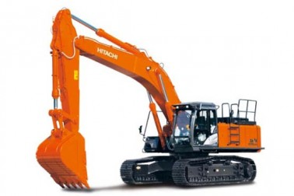
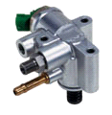
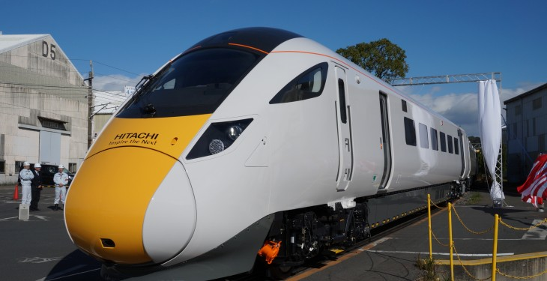


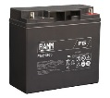
2-3. Manufacturing sites in Europe
Amsterdam & Oosterhout: Hitachi Construction Machinery (Europe) (Excavators, Wheel loaders)
Sachsen: Hitachi Automotive Systems Europe(Automotive components)
Newton Aycliffe: Hitachi Rail Europe (Rolling stocks)
Bolton: Hitachi Automotive Systems Europe (Automotive components)
Tver Region: Hitachi Construction Machinery Eurasia Manufacturing (Excavators)
Zatec: Hitachi Cable Europe (Brake hose) Hitachi Automotive Systems Europe (Automotive components)
Riom: Ansaldo STS
Pistoia, Naples, Reggio Calabria:
Hitachi Rail Italy
(Rolling stocks)
Tito Scalo: Ansaldo STS
(signalling systems)
Verona , L'Aquila:
FIAMM Energy Technology
(batteries)

Slide 12



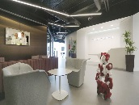
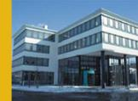

2-4. European Research & Development Centre
London: - Hitachi Design Centre Europe [Since 1989
Experience Design & Branding]
- Transportation, Energy & Environment Research Laboratory
[Since 2005
Rail, Automotive & Power]
- NEXPERIENCE/Space
[Since 2017
Collaborative Creation for Solution Development]
Cambridge:
- Hitachi Cambridge Laboratory
[Since 1989
Leading-edge Physics]
Manchester: - European Big Data Laboratory
[Since 2013
Big Data & Smart Mobility]
Copenhagen: - European Big Data Laboratory
[Since 2013
Big Data & Smart Mobility]
Munich: - Transportation, Energy & Environment Research Laboratory
[Since 2005
Rail, Automotive & Power]
Sophia Antipolis: - European Big Data Laboratory
[Since 2013
Big Data & Smart Mobility]

Slide 13
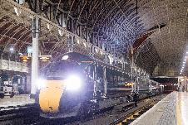

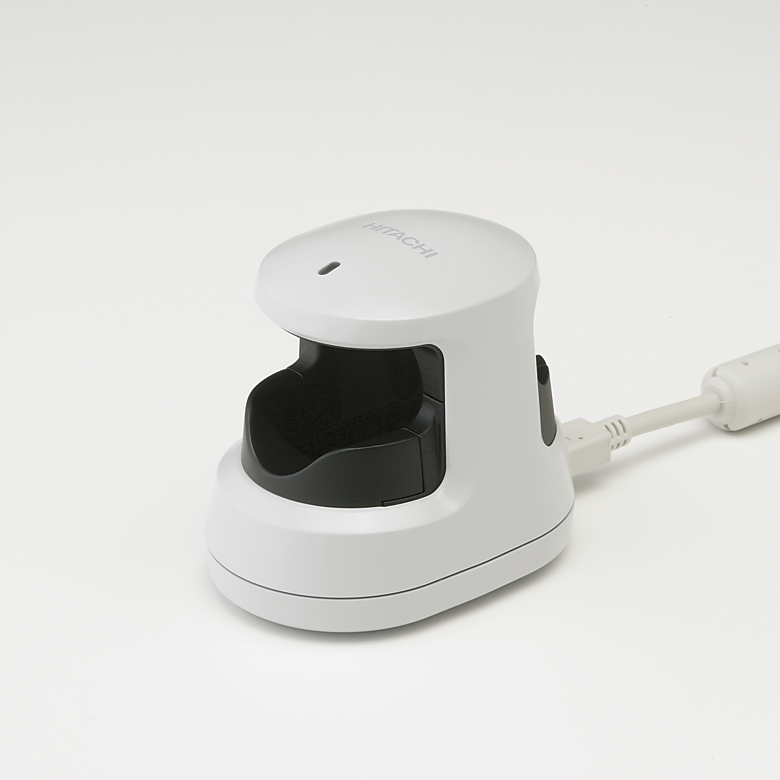
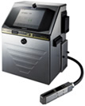

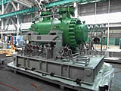

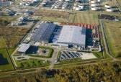
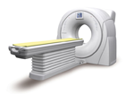
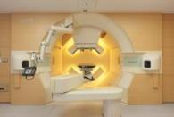



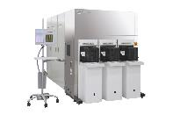
2-5. Overview of major businesses in Europe
Social Infrastructure & Industrial Systems
IT Systems & Solutions
Rail Systems
Service
Rolling stocks
Signaling systems
IT Service, Data Centre Solutions, Consulting
System Solutions
Industrial Products
Large-scale systems, Highly reliable systems
Finger Vein Authentication
Marking Systems
Transformers
Compressors
Platforms
Hardware, Software
Construction Machinery
Electronic Systems & Equipment
Particle Beam Therapy System
Hydraulic Excavators
Healthcare systems
Diagnostic Equipment
Wheel Loaders
Mining Equipment
Semiconductor Manufacturing Equipment

Slide 14
1. Overview of Hitachi
2. Introduction of European Business
3. How much should finance cost?
4. How do you use a Shared Service?
5. Which Technologies make a difference?

Slide 15
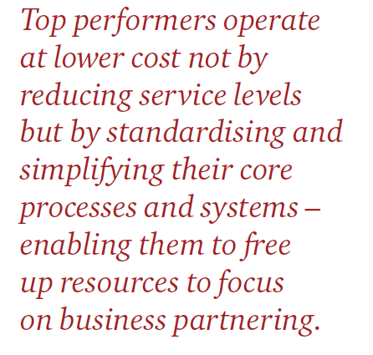
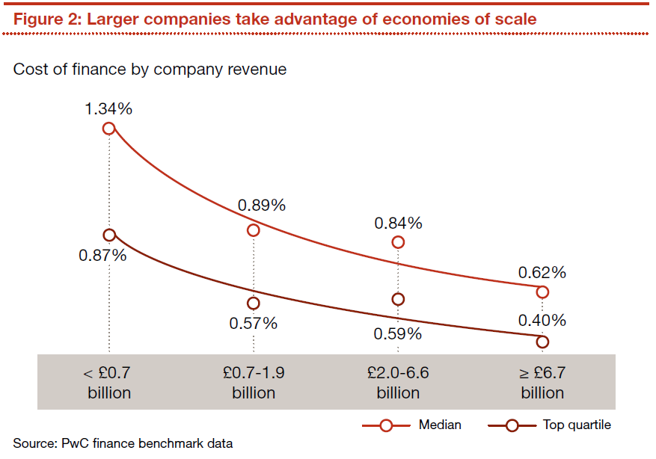
PWC: Cost of finance as a % of revenue

Slide 16
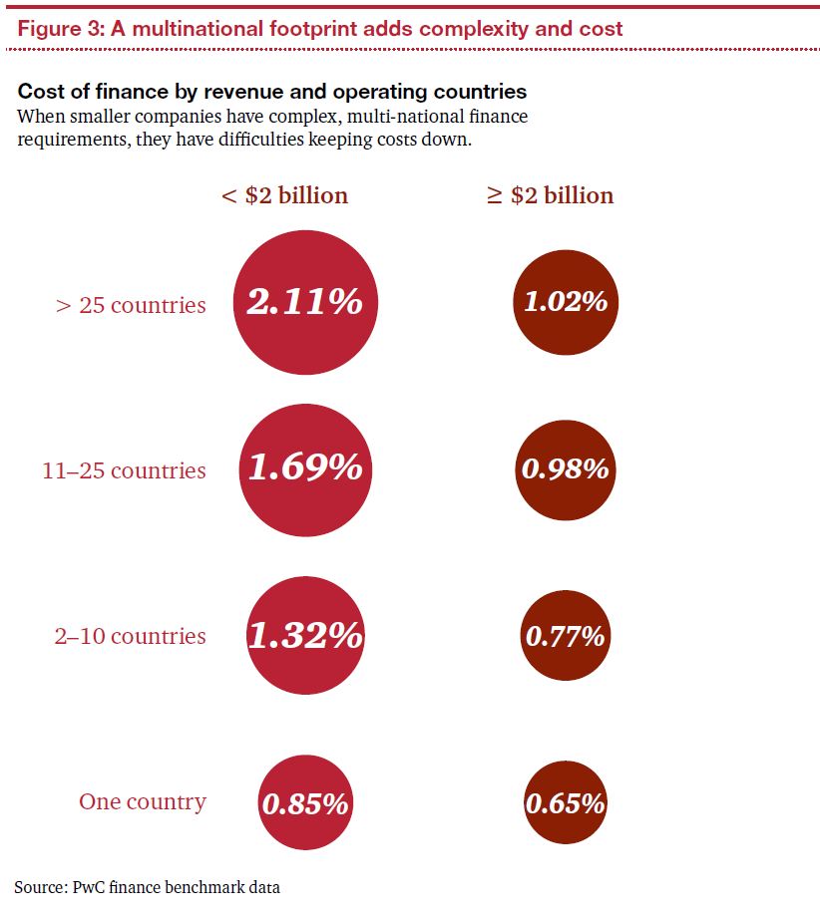
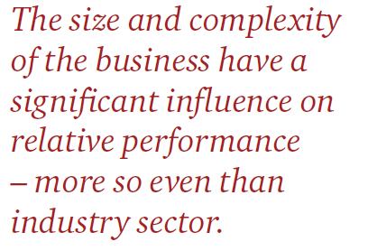
PWC: Cost of finance as a % of revenue

Slide 17
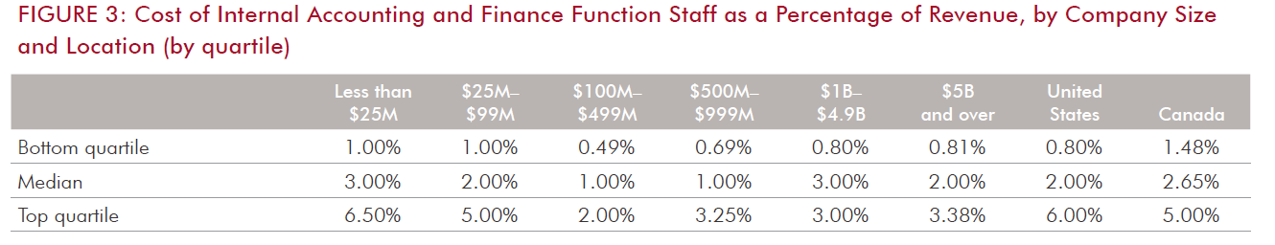
Robert Half: : Cost of finance as a % of revenue

Slide 18
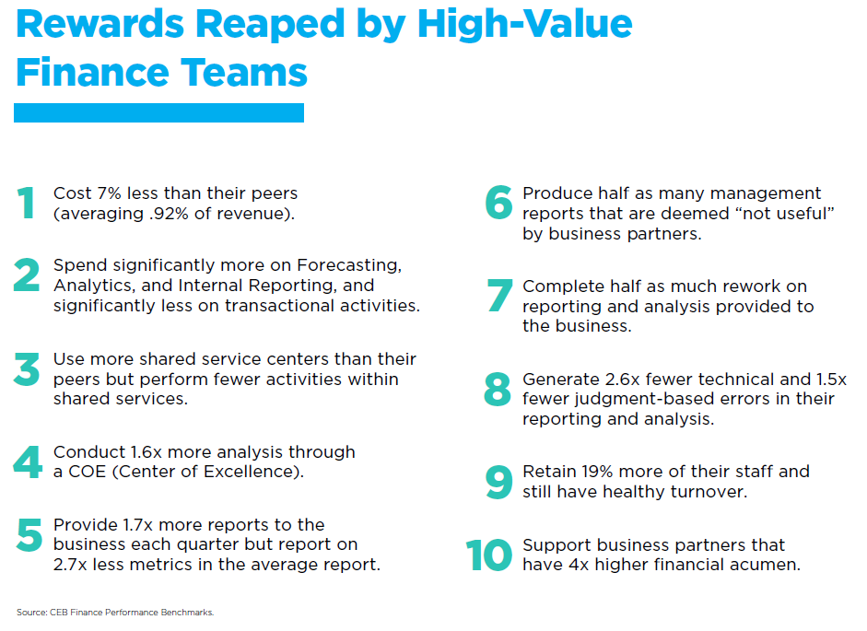
Gardner: : Cost of finance as a % of revenue
0.92%

Slide 19
1. Overview of Hitachi
2. Introduction of European Business
3. How much should finance cost?
4. How do you use a Shared Service?
5. Which Technologies make a difference?

Slide 20
Diversity of systems
Drivers of Complexity:
Operating Model is very complex, costly and involves much duplication of resources:
130+ Legal Entities
400+ Properties
30+ ERP systems
27+ Group companies
27+ Executive Teams
4+ Corporate Services Operating Models
3 x Shared Services Models (HEU, Vantara, HCC)
24 x Operating Company Models (each is different)

Slide 21
Shared Service Objectives
Reduce number of systems to achieve better standardization
Focus on core processes similar in most industries
AP, AR, Reporting, Tax, Internal Audit
Reduce Operational Costs of Finance
Improve Compliance, Accuracy, Quality of service, Transparency

Slide 22
Decentralised versus Centralised dilemma …
IA, Tax, FP&A
Number of systems
Value Added
+
+
Value Added of Finance
Cost per transaction
Reporting
AR, AP
-
-
-
+
-
Proximity
+
Volume of transaction per system

Slide 23
Local Decentralised West Europe / Distant Centralised Central Europe
Western Europe
Customer Facing
Low Cost Country
Non-Customer Facing
CHANGE MANAGEMENT
Migrate local systems to GSSC
Migrate jobs to GSSC
Adjust Processes and Deliveries
INTERFACE WITH CUSTOMERS
Ad hoc analysis
Forecast and Budget
Actuals Performance Analysis
Operate the standardized systems:
Balance Sheet reconciliations
Reporting, planning software's admin
OCR and workflow for AP
Travel expense claims software
AR software
VAT software
…
Overtime, migrate as many jobs as possible to Low Cost Countries
Most systems being cloud based, they can be operated from any place

Slide 24
1. Overview of Hitachi
2. Introduction of European Business
3. How much should finance cost?
4. How do you use a Shared Service?
5. Which Technologies make a difference?

Slide 25
Which Techno makes a difference?
Account Receivables
Cash Allocation
Reminders
Account Payables
Travel Expense Claims
INPUT
ERP
(SAP – Oracle - …)
Bal. Sheet Reconciliation
OUTPUT
Reporting
Data analytics
Tax returns
Group – Stats
VAT
Planning & Analysis

Slide 26



Which Techno makes a difference?
Account Receivables
Cash Allocation
Reminders
Account Payables
Data entry
Travel Expense Claims
INPUT
ERP
(SAP – Oracle - …)
Bal. Sheet Reconciliation
OUTPUT
Reporting
Data analytics
Tax returns
Group – Stats
VAT
Planning & Analysis

Slide 27
Which Techno makes a difference?
Account Receivables
Account Payables
Travel Expense Claims
Integrated solution:
-Credit risk / max balance
- Insurance
-Auto. reminders
-Auto. Cash allocation
OCR + Workflow
ITeSOFT
Book travels
Input travel expense
Workflow approval
Accounting
Payment
CONCUR
INPUT
ERP
(SAP – Oracle - …)
Online BS recs
Done in India
CADENCY
Bal. Sheet Reconciliation
Reporting Data base with Budget and Actuals
Autom. Dashboards
BPC
Excel front end with links in database
Manages Budget data collection
Report and analyse
BPC
OUTPUT
Reporting
Autom. GL download in VAT soft
Hundreds of returns per quarter
Big4 software
Data analytics
Tax returns
Group – Stats
VAT
Planning & Analysis

Slide 28
Robotic Process Automation
In this context of Automation and Virtual Network, we have started analysing the benefits of RPA.
First things first : Chronology:
Automate : digitalisation of processes: OCR, Workflows, etc…
Integrate: use similar systems and tools across the Group
Then only consider implementing RPA
Understand what can be “RPAed”:
A Robot will not do “manual” work like placing a call or walk down the corridor
A Robot can only address processes that are fully digitalised and rules based.
Avoid “subjectivity”. A robot can only address objective measures and decisions. Mainly “what if” scenarios
A robot can manage data from multiple different software and follow a path, a script.

Slide 29
RPA
Cost:
A robot is estimated at £10k a year to operate including the license fee
Add a similar amount for implementation: define scripts and program the robot
Apply a robot to a “Bad” process is not good. Fix your processes first
One robot is worth it only for a process well defined
Critical size: A robot is worth it if it addresses a process today performed by more than 5 employees.
In the case of Hitachi Europe, because of the diversity (30+ legal entities with different systems) and the small size of our tasks, we have not yet found an eligible process to robotise.
Through further standardization and transaction volume growth, we expect to be able to start in 12 months time.

Slide 30
Notes:
本日は有難うございました。

