Slide 1

Bank Connectivity: SWIFT, EBICS, H2H or API – What’s best for your Treasury?
Treasury Leaders Summit
November 19, 2019
Simon Kaufmann

Slide 2


Simon Kaufmann
Head Client Relations and Marketing
Fides Treasury Services
www.fides.ch
Email: hello@fides.ch
https://www.linkedin.com/in/simon-a-kaufmann/

Slide 3
Agenda
Introduction
Common treasury pain points
Bank connectivity solutions overview
The value proposition of a bank connectivity solution
Case studies
Where to start your journey?

Slide 4
Common treasury pain points
Cash visibility & cash management
Operational risk
Security and compliance
Decentralized systems
Time-consuming manual processes
Notes:
In the past decade — or more — there has been surprisingly little change in the pain points involved with treasury operations.
But while cash management, security, and operational risk remain significant concerns, most of these are caused by decentralized systems.
And another direct result of that decentralization is that it takes far more time than it should to get your job done. Between bank portals, spreadsheets, ERPs, treasury management systems and more, there are a lot of places where problems can arise.

Slide 5
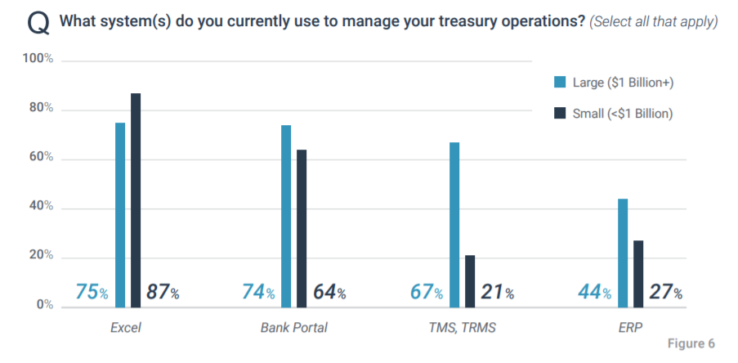
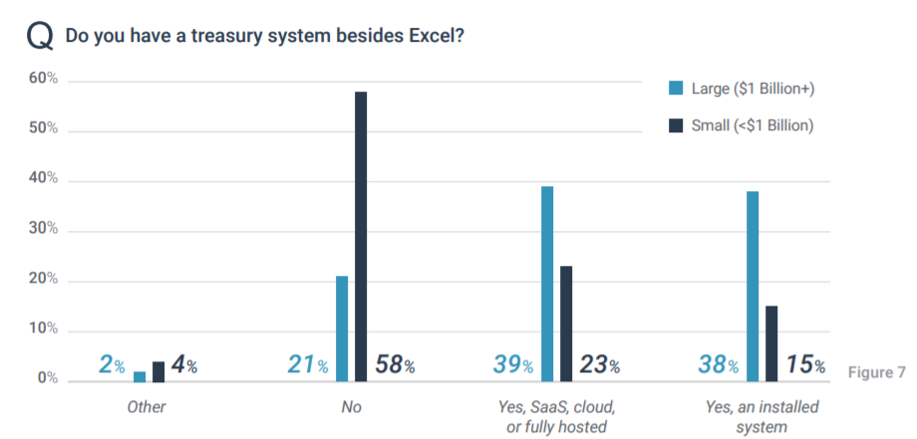
Corporate & TMS market
Treasury technology – by the data
Source: Strategic Treasurer Treasury & Risk Management Systems Report 2018
Notes:
At this point in time, the use of treasury software throughout the corporate environment is fairly high. Although significant opportunities remain for small and mid-market firms to find a solution to address their needs, the continued «democratization of technology» with regard to price points and capabilities is having significant influence on the adoption rates of these markets.
While Excel continues to be used by the majority (80%) of organizations, this use of spreadsheets is frequently coupled with a more sophisticated solution, such as a TMS or ERP. According to Strategic Treasurer’s 2018 Rapid Research Tech Use Survey, half of corporate treasury departments (50%) were using a TMS, and 38% were using an ERP.

Slide 6
Plenary Questions
Who of you is still using bank proprietary portals (e-banking)?
Who of you has implemented a TMS or is in the process?
Who of you is connecting to some banks via API’s?
Who can connect all his banks via API’s?

Slide 7

A typical corporate-to-bank landscape
SMS TAN
E-Banking
API
EBICS
Global Active Corporate
Host-to-Host
Security
Token
Fax-Banking
SWIFT
Notes:
But, the corporate-to-bank connectivity landscape is complex. There are many options for connectivity channels – SWIFT, EBICS, Host-to-Host, and more.

Slide 8
SWIFT
Most commonly used communications protocol globally
Multiple connectivity options:
  Alliance Messaging Hub (AMH)
  Cloud-based Alliance Lite2 and AL Cloud
  Service Bureau model (Alliance Access)
A bank may be on the SWIFT network, but not part of SWIFT SCORE
Best for: Service Bureau model for high volume of banks and accounts, AL2 for smaller setups, AMH large enterprise groups
Notes:
SWIFT is the most commonly known and widely used banking communications network.
But while direct SWIFT connections provide the necessary multi-banking connectivity, they also require a significant investment - not just financially, but also time- and resource-wise. A bank may be on the SWIFT network, yet still require connectivity via the lead bank model.
Alliance Lite2 can be a good solution for organizations that do not anticipate significant fluctuations or scalability requirements.
With SWIFT’s service bureau model, corporates may choose to retain a third party (vetted by SWIFT) to maintain and manage their SWIFT BIC – which may be easiest for businesses on a growth trajectory who do not want to maintain an extensive IT team to manage treasury operations. The SWIFT service bureau option allows large enterprise groups to have the most flexible setup, with additional services tailor-made to their diversified ERP and/or TMS setup within the company group.

Slide 9
Host-to-Host
Available from most banks
May be cost-effective, particularly if bundled with other bank services
Can be complex and time-consuming to implement
Lack of data standards, formats, and validations
Mainly file based transmissions
Requires IT resources to manage and maintain
Best for: connecting to a small number of domestic banks with high-volume transactions
Notes:
Host-to-host connections are available from most banks but may be time consuming and complex to implement: host-to-host on-boarding can be slow due to having no standardized data standards, formats, and validations. Internal resources are required to manage and maintain the channels.
But while it may require some extra work, host-to-host connections can be a good choice if you are working with a small number of banks with high-volume transactions.

Slide 10
EBICS
Most commonly used channel for payments in Germany (Europe)
Widely used in France, Austria and Switzerland
No charge for transactions in Germany & France
Can be used to transmit SEPA payments
Offers a higher level of flexibility for corporates wishing to avoid being locked in to one specific core bank
Best for: high-volume transactions to European banks
Notes:
The EBICS protocol is an alternative to SWIFT, which has the potential to become a European standard. For banking in Germany, France, Austria and Switzerland, EBICS provides a secure communication channel that can simplify the connectivity process.
EBICS 3.0 allows banks to provide standardized access for multiple countries on the basis of one standardized and fully harmonized infrastructure, and can also be used for clearing access for Single Euro Payments Area (SEPA) payments.
While EBICS is not yet a global or even an European standard, adoption is growing. It is affordable to implement, and there is no charge for transactions in France and Germany (vs. using SWIFT). Using EBICS also offers a higher level of flexibility, as it would be easier for corporates to transfer business from one bank to another.

Slide 11
API’s – Application Programming Interface
Driven by PSD2 initiative in Europe
Major banks globally started to develop and offer API’s for various business practices
Real-time account information and payment execution on demand
Offers more flexibility and faster connections to banks and other providers
Adaptation growing but still very limited to certain banks
Best for: Connecting to core banks with the need for real-time information and payments processing besides new payment providers
Notes:
The EBICS protocol is an alternative to SWIFT, which has the potential to become a European standard. For banking in Germany, France, Austria and Switzerland, EBICS provides a secure communication channel that can simplify the connectivity process.
EBICS 3.0 allows banks to provide standardized access for multiple countries on the basis of one standardized and fully harmonized infrastructure, and can also be used for clearing access for Single Euro Payments Area (SEPA) payments.
While EBICS is not yet a global or even an European standard, adoption is growing. It is affordable to implement, and there is no charge for transactions in France and Germany (vs. using SWIFT). Using EBICS also offers a higher level of flexibility, as it would be easier for corporates to transfer business from one bank to another.

Slide 12
Managing connectivity
Connectivity Options
Global Banks & Payment Providers
TMS
or
ERP
SWIFT
Global Active Corporate
Host-to-Host
EBICS
Bank
Connectivity
Provider
APIs and Others
Notes:
The corporate-to-bank connectivity landscape is complex. There are many options for connectivity channels – SWIFT, EBICS, Host-to-Host, APIs and more.
Not only are there all the choices of channels, there are the choices on how to go about managing your bank connectivity:
In-house, set up and maintain direct connections with each bank
Use a TMS/ERP, manage through those vendors
Manage through a bank connectivity provider (also sometimes called a treasury aggregator)

Slide 13

Are you experiencing any of these issues?
Rapid growth and geographic expansion
Difficulty with messaging formats and connectivity channels
Concerns about security and compliance surrounding payments
Mergers and acquisitions resulting in multiple treasury and payment platforms

Slide 14
A bank connectivity solution may be the answer
Centralized Access, Single Login
Streamlined Payments and Reporting
Operational Efficiencies / Automation
Multi-bank
Connectivity
Comprehensive Visibility into Cash Position
Enhanced Security and Risk Management
Flexible, Scalable Integrations with TMS & ERP systems
Notes:
When most treasurers think of financial software, they think of treasury management systems. And they believe that a TMS can do everything.
But what treasurers DON’T realize is that bank connectivity is not native to most TMSses. Even if it is built in, it is often rudimentary and cannot cover all the banks and formats that many corporations wish to use.
A bank connectivity solution can help you streamline payments and reporting activities.
Effectively, it provides you with a single, unified point of access that consolidates all of your data from all of your banks, giving you a comprehensive view into all activities.
No more logging into individual bank portals.
No more manually taking that data and entering it into spreadsheets.
And, you can implement a bank connectivity solution at any time. It can be the first step in your journey from a spreadsheet to a TMS, can be a standalone option, or can be integrated with any TMS or ERP to provide better global connectivity and straight-through processing.

Slide 15
Why opt for a bank connectivity provider?
Maybe you don’t need a TMS — or aren’t yet ready to implement one
Restrictions on supported protocols and formats from your existing or prospective banks or connectivity channel
Faster time-to-market onboarding new banks
Work with specialists who are experienced in dealing with different connectivity channels and formats
Notes:
There are a number of reasons why you may wish to de-couple bank connectivity from your TMS. Maybe you don’t even have a TMS – many large organizations are reliant on ERP systems, and smaller organizations who are still in growth mode may not yet have decided on a solution. Or, maybe you have a TMS in place but are thinking of changing providers. In most cases, bank connectivity you may have set up within any given TMS is not transferrable.
If you have a large enough budget and staff, you can manage your bank connectivity directly. But even some large organizations prefer to outsource as bank connectivity is not one of their core competences.
Even with outsourcing, you have choices. Some companies wish to outsource, but still to centralize everything through one vendor and only deal with one relationship. In that case, it is wise to look for a TMS provider who partners with a bank connectivity provider. The trade-off of course is that it may take longer to implement connections.
With a bank connectivity provider, you can send payments and messages of any format to any institution anywhere in the world.
And at the touch of a button, reconcile bank balances, transactions and booking texts from any of your banks around the world.
A good bank connectivity solution both simplifies and streamlines treasury operations, freeing up your time from some of the administrative tasks to concentrate on the more strategic needs of the business.

Slide 16
Benefits of third party bank connectivity
Automated reporting: save time, reduce the risk of manual error, and get the cash visibility you need, far faster than possible with spreadsheet reporting
Cash management: make and receive secure low-latency global payments in the currencies of your choice
TMS/ERP connection: integrate your connectivity solution for seamless access to existing data, analytics and reporting capabilities
Flexibility/portability: if you choose to change TMS or ERP vendors in future, you will not lose any of your bank connections
Notes:
Using a third party bank connectivity solution provider has a number of benefits — not the least of which is reducing the amount of time you need to spend working with spreadsheets!

Slide 17
Things to look for in a connectivity provider
Are they transparent with their operations?
Are they a strategic player in this business?
Is running a connectivity bureau a core competency?
Do they have scale and international reach?
Are value-added services offered?
Do they have key banking relationships?
Do they offer all available connectivity options out of one hand?
Notes:
It is essential to know who and what you are dealing with: large providers who make public filings are more attractive partners than smaller privately owned bureaus.

Slide 18
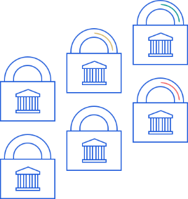
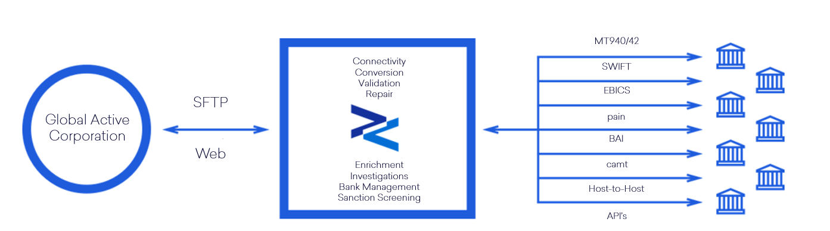
Fides: global reach like no other!
11,000 branches across the SWIFT network of banks.
2,000 branches across SWIFT SCORE
Banks reachable via EBICS
Banks reachable via H2H
Banks reachable via API

Slide 19
Case Studies

Slide 20
“We wanted only one connection to our banks, which means Fides.”
– Bogdan Carnaru
Treasury Project Manager
Millicom

Slide 21

Case Study: Bank Connectivity Without a TMS
Business Challenges
Lack of visibility into global treasury operations
Too much time spent on manual tasks
Standardized on MT940s, need to communicate with banks that use other formats
Decentralized operations
Benefits
Visibility into global cash flow
Centralized payment workflows for increased control
Automated data aggregation and file conversion with ERP integration
Improved operational efficiencies and reporting
Industry: Telecommunications & Media
Headquarters: Luxembourg
Employees: 18,000
Multiple ERP systems
Multiple versions of ERPs
No TMS
Notes:
Millicom handles hundreds of accounts globally through multiple banks located in
various parts of the world, using multiple ERPs. The company needed greater
visibility into its global treasury operations, more automated, scalable bank connectivity, and a centralized user interface.
Millicom uses Fides ARS to receive MT940s from its banks, host-to-host transmitted in files divided per country and bank. For banks that do not send/accept MT940s, Fides builds converters.
Millicom uses Fides EFT for MT101 SWIFT network messages. Millicom sends XML pain.001 files to Fides via host-to-host connection. Fides converts those files to MT101 format and sends to the bank via the SWIFT network.
“Last year, Millicom established host-to-host connections with some banks in LatAm for our operations - at least 2 banks in each country. Next year we will move to a new version of our ERP. Without Fides, we would have had to rebuild all fifteen connections individually” – Bogdan Carneru, Treasury Project Manager, Millicom

Slide 22
“What used to take half a day of my time now only takes an hour or two – the process is much smoother. We’re saving at least 15 hours a week, and the quality of the data is much better than what we had before.”
– Megan Kasparian
Senior Treasury Analyst
American Tower
Notes:
Not sure that a bank connectivity solution can really save that much time? Here’s a quote from one of our customers. Much of the 15 hours saved were spreadsheet-related.

Slide 23
Case Study: Integrated TMS + Bank Connectivity
Business Challenges
Fast business growth and decentralization
Need to consolidate and automate manual processes
Build connections with new banks that may not adhere to standardized formats
Execute payments globally
Benefits
Unified treasury management system with one vendor point-of-contact
Savings of 15 hours of time per week for treasury staff
Reduced business risk
Industry: Wireless & Broadband Communications Infrastructure
Headquarters: Boston, MA
Employees: 4,500
Global connectivity:
  35 banks
  300+ accounts
Notes:
American Tower has a global footprint, working with 35 banks and 300+ accounts
around the world. The company wanted to implement a treasury management solution that would automate manual processes and unify treasury operations.
The American Tower team selected Reval as their TMS provider. Initially, the team was more concerned with TMS capabilities than with bank connectivity. But
when they started to centralize global treasury operations, they found Reval’s partnership with Fides to be a valuable asset.
Using Fides through their Reval agreement, American Tower onboarded more than 300 bank accounts and set them all up with automatic bank account statement
reporting. This streamlining saves their treasury team approximately 15 hours per week of manual administrative work.
“Payments connectivity can be very painful. Reval chose wisely when they selected Fides as their bank connectivity partner: Fides is used to working with the banks and already has connections with many of them. If there is no existing connection, they will build one.” – Jeff Williams, Senior Director of Treasury, American Tower

Slide 24
“Fides converters allow us to make payments with banks where otherwise we would be at an impasse. Without Fides being in the middle, our TMS wouldn’t be able to process all the non-standard messages, but Fides has programming that knows how to split items and provide the information in the format that each specific bank needs it in.”
– Eli Brown
Treasury Process Controller
UPS

Slide 25

Case Study: Implementing TMS + Bank Connectivity
Business Challenges
Decentralized treasury systems caused increased organizational risk and decreased efficiency
Need for global cash visibility
Need to physically concentrate cash
Manual processes were time-consuming and often resulted in inaccurate results
Benefits
Global cash visibility and concentration
Centralization of banking services
Reduced risk
Streamlined business processes
Industry: Global logistics & package delivery
Headquarters: Atlanta, GA
Employees: 454,000+
120+ banking partners
Accounts in 76 countries
Notes:
Prior to 2016, UPS leveraged a domestic US treasury system, a homegrown international system, and a large number of banking platforms to manage cash.
UPS had 90+ different electronic banking portals with 2,500+ users in business units around the world, making it extremely challenging to manage and control funds and impossible to track who had access to make payments on behalf of the company.
Each day, staff would have to go into a web-based tool and estimate their daily receipts and disbursements. It was a manual and inaccurate process with hundreds of forecasts submitted daily. Global visibility was a severe challenge as there was no central reporting and no global comprehensive repository.
And, regulatory shifts were changing the landscape of how UPS could concentrate cash, putting over $2B in international liquidity at risk if they could not replace their notional cash pooling structure with physical funds transfers.
UPS started the project in April 2016, with an aggressive timeline of moving 80 percent of global cash balances by October of that year. That meant only a six month implementation timeframe to stand up the system and get bank connectivity to the first 200 accounts within banks located across 10 countries. They worked with Reval and Fides to put a TMS & bank connectivity solution in place.
UPS uses the SWIFT Network for all payment processing, leveraging the Fides BIC and their own corporate BIC (which Fides helped the company establish). The option to use Fides’ BIC to make connections with the first wave of banks made it possible for UPS to meet its aggressive regulatory compliance-driven project implementation timeline.
Having an automated payments process and a central repository eliminates the need for multiple complex spreadsheets and manually compiled data. This automation also significantly reduces human error, making the data cleaner and more accurate.
“The visibility provided by Fides has greatly increased our efficiency in managing cash and cash assets, which is ultimately what treasury is about.” – Eli Brown, Treasury Process Controller, UPS

Slide 26
“Having all the information in one place gives us the ability to get the big picture fast. It saves manual work, gives us the info to be able to make a decision and analyze quite quickly. Our company is growing very fast, and it is mandatory that we have systems to support that growth and support the work that we have to keep up with in our environment. Without Fides, we would not be able to support the scaling of our business.”
– Revital Gadish
SVP, Finance and Treasury
Payoneer

Slide 27

Case Study: Separate TMS + Bank Connectivity
Business Challenges
Fast business growth and expansion
Aggregate data from a large number of diverse providers
Enable treasury to analyze that data
Execute payments globally
Benefits
On-boarding of even banks using non-standard connections and formats
Automation of manual processes
Faster transaction processing, communication, and reconciliation
Bank connectivity integrates seamlessly with TMS
Industry: Global payments
Headquarters: New York, NY
Employees: 1,000
50 bank & payment providers
500 accounts
150 currencies
200 countries
Notes:
Payoneer deals with disbursing payments around the world in a variety of ways, including wire transfers, local bank transfers, credit cards, echecks and more, in
multiple currencies.
Many of their banks are small and are not on the SWIFT network, requiring
some unique solutions. With Fides, in the first year, Payoneer was able to onboard
~ 180 bank accounts and as of late 2017 has 270 accounts managed by Fides.
Fides connects to both the Kyriba TMS and the banks.
“Fides was able to support our wide variety of unique vendors, and was quite helpful in offering creative solutions and alternatives to support the small non-SWIFT banks and payment providers who could only provide transaction information via email.” – Lital Lahav, Treasury Director, Payoneer

Slide 28
Where to start your journey?
Review current banking landscape: Define core banks and decide on services required of each particular bank in scope
Review internal processes: Current effort for cash management processes, requirements for a real-time environment, pro/con for a TMS/ERP, level of security with current processes, required internal IT resources for current setup
Review current interaction with banks: still using proprietary banking portals, quality of TMS/ERP in place, connections to banks?
TMS/ERP connection: Analyze current connectivity solution in place. Are all banks connected or do you have certain banks out of reach?
Flexibility/portability: Define your required and preferred level of flexibility to exchange existing banks, TMS/ERP vendors and/or connectivity provider and their individual services provided and future roadmap

Slide 29
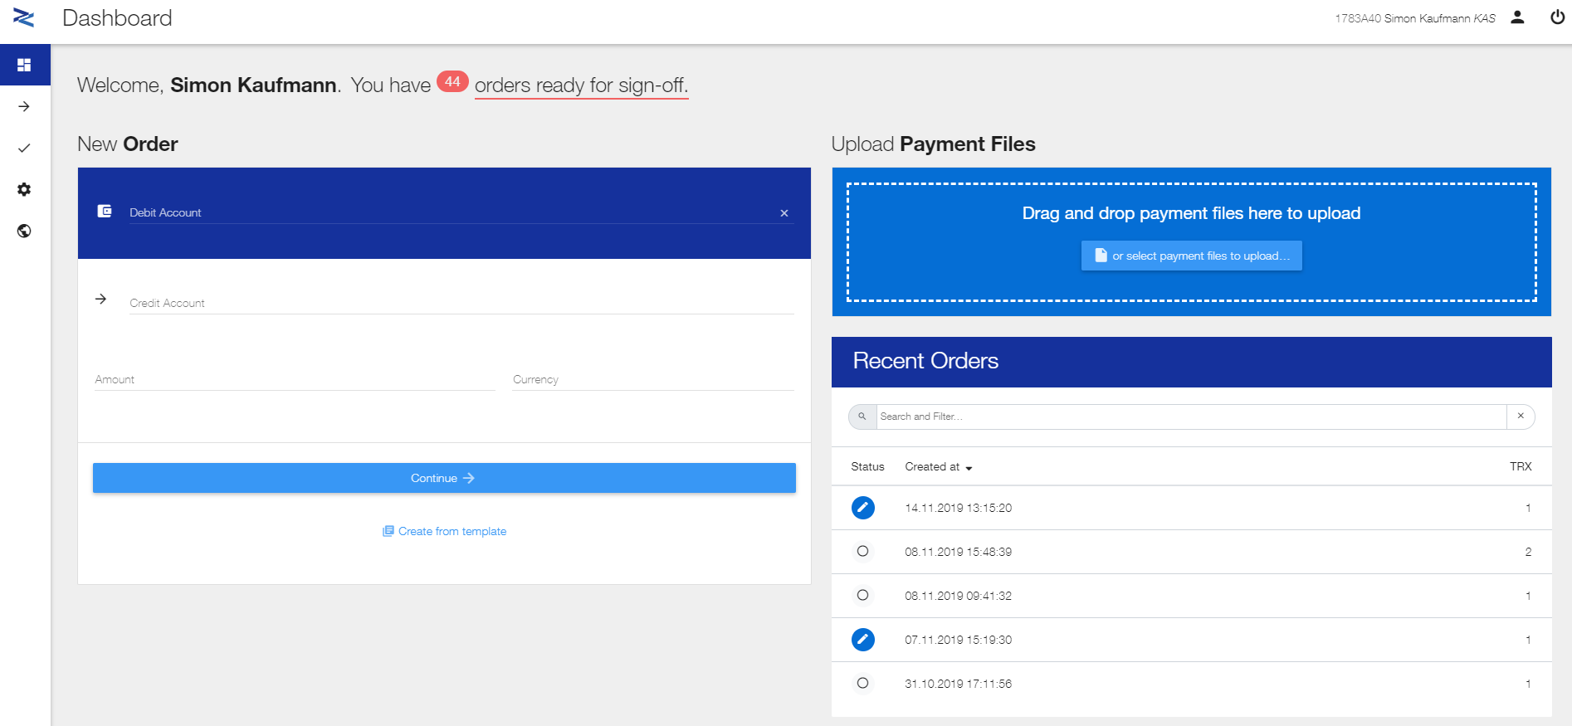
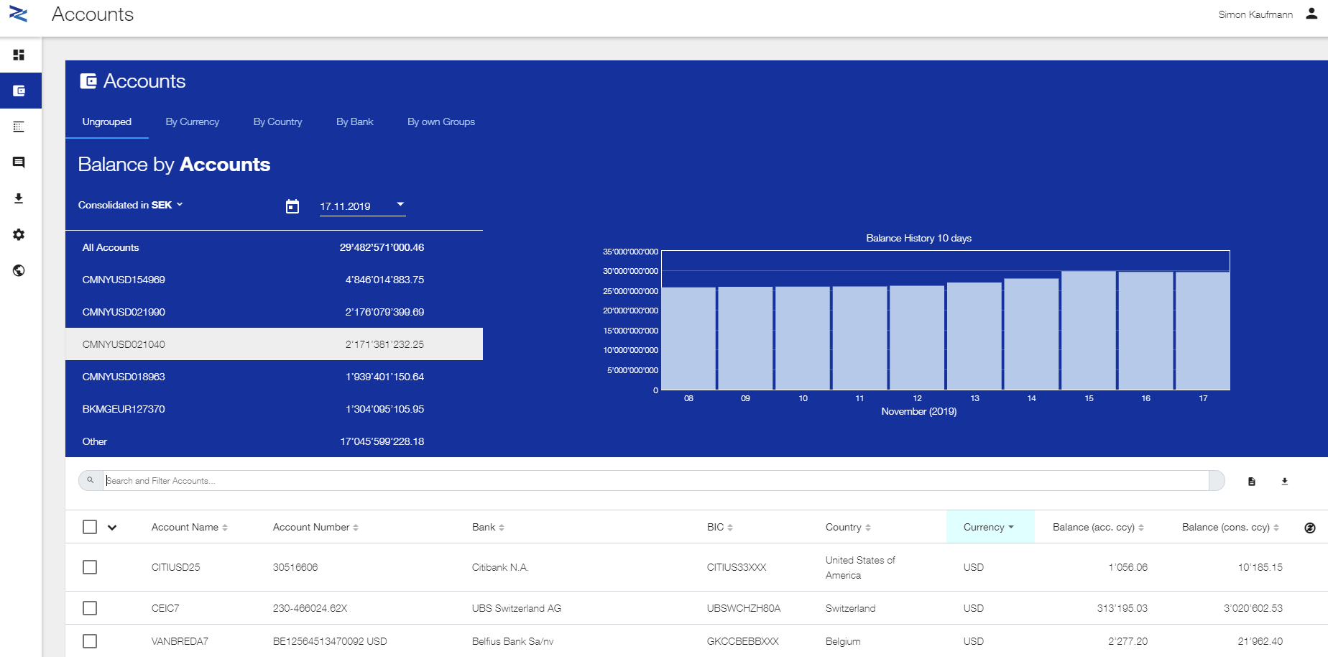
Possible starting point to automate and digitize
Live demo of Fides Multibanking Suite

Slide 30
Q & A
Does it make sense to be a SWIFT member?

Slide 31
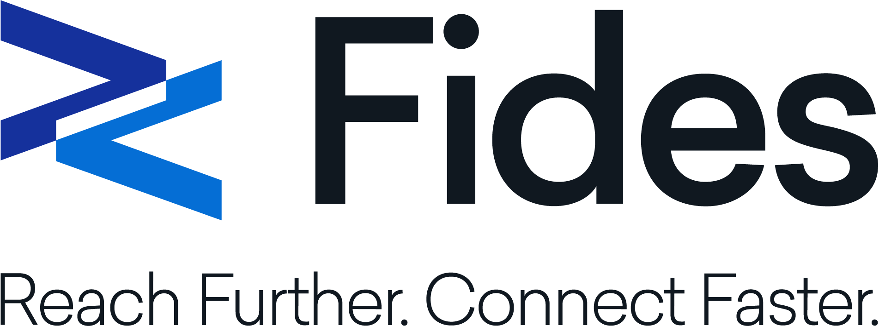
Does it make sense to be a SWIFT member?
www.fides-treasury.com
hello@fides.ch

Slide 32
Annex

Slide 33




Fides
100+ years of connectivity and multi-banking excellence.
Scalable multi-banking services since 1985
Audited by KPMG, SWIFT, Credit Suisse
3,000+ clients worldwide
Messages from 170+ countries reconciled daily
Connectivity to 10K banks globally
$5.5 Trillion+ in
payments
processed annually
Including Payoneer, Trafigura, NCR, AES, UPS, Volvo Cars and more
The only true Hybrid Service Bureau
Notes:
Since 1985, Fides has focused purely on multi-banking and connectivity. Fides helps more than 3,000 clients communicate with more than 10,000 banks within 170 countries.
We can facilitate communication via any channel – including SWIFT, EBICS, and Host-to-Host (H2H) – and support any format (all SWIFT MT formats, ISO20022, ACH, EDI, AFB, DTA, ABA and many more, enabling corporates to connect to any bank in any region worldwide.
Fides can connect with any TMS, ERP, bank, or network. Many of the most popular TMS solutions even incorporate Fides software directly into their platform.

