Slide 1
Treasury DIGITAL TRANSFORMATION
Brenda Schreuder
Treasury Leaders Summit LDN, November 19

Slide 2
Agenda
Introduction to Amgen
Amgen Treasury Organization
Digital Transformation Strategy
Treasury Current System Landscape
Treasury Future System Landscape
Robotics
AI
How to obtain management buy-in and funding
Timing of Implementation
Who and what skill set is needed
Key Take Aways

Slide 3

AN introduction to AMGEN
At Amgen, we believe in a “biology first” approach. We use cutting-edge science and technology to study the subtlest biological mechanisms in search of therapies that will improve the lives of those who suffer from serious diseases. Amgen believes the cure for disease can be found inside each and every one of us.

Slide 4
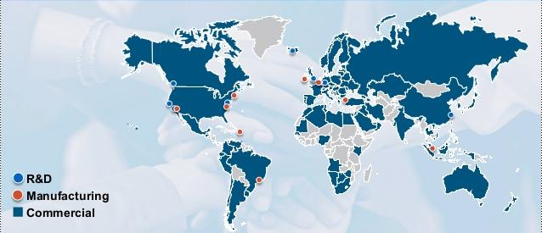
Amgen treasury organization
Risk, FX/Investments, Cash Mgmt,
Customer Finance
Cash Mgmt/CF
Strategy
Cash Mgmt/
Inhouse
Bank/
CF
Cash Mgmt/CF
2019 highlights:
2 acquisitions (Otezla, Nuevolution)
Amgen takes 20% stake in Beigene (China)
Expansion South East Asia (MY, PH, TH, HK, SG) and Argentina
System/Process Automation

Slide 5



Digital transformation strategy
System Harmonization
Robotics
Artificial Intelligence

Slide 6
Current-state treasury system landscape
Transformation Priority
C
Critical
H
High
M
Medium
Payroll – Fraud Sensitive
9 Interfaces
Complex Approval Process
Bank Communication
Treasury & Risk
Mgmt
Multiple Platforms
90% manual
BCM
50% Accuracy
100% Manual
Cash & Liquidity Forecast Online Tool
SAP
CORE
Collection
Mgmt
Credit Control
Cash Accounting
Rule Based
Inhouse Cash
60% recognition rate
3 FTE fully occupied
Dispute
Mgmt

Slide 7
Future-state treasury landscape
Enabled by sap s/4hana
Bank Communication
Single platform to manage and approve payments
Integration with Bank Account management tool
Bank-agnostic payment solution
General
Connected enterprise (11 systems)
Unified master data model
Lower overall TCO
Bank Comms
Treasury & Risk Mgmt
BCM
Credit Control
Treasury and Risk Management
Exposure management and Hedging integrated into CFF
Native connection to trading platforms
Automated hedge accounting
Intelligent predictive modelling
Cash & Liquidity management
70% accuracy
Integrated cash concentration
Integration with OTC, PTS and IC
Cash & Liquidity Forecast
Collection
Mgmt
SAP
CORE
Cash Accounting
Dispute Mgmt
Cash Application
Recognition rate ~95% via Machine Learning algorithms
Reduced FTE (~1 EW)
Inhouse Cash
Credit Control, Collection & Dispute management:
One straightforward process
Single source of truth
Intelligent reporting system with high level of automation

Slide 8
Proposal for Treasury transformation roadmap
*2021+
Phase 3 = Focus on Exposure Mgmt & Credit/Coll/Dispute
*2020
Phase 2 = Focus on Cash Flow Forecasting & Bank Communication
2019
Phase 1 = Focus on Cash Flow Forecasting & Cash Application
Implement S/4HANA to improve:
  Hedging
  Credit/Coll/ Disputes
Convert cash / bank functions to S/4HANA
Expand CLM per approved roadmap
Multibank Cash Pooling in China
Bank communication automation
Current-State
Implement Cash & Liquidity Mgmt (CLM)
Create CLM Expansion & CI Roadmap
Replace Autobank with SAP Cash Application
2 Treasury platforms
9 interfaces to banks
Manual data exchange
High TCO
Manual-intensive processes
*Timing of move to SAP S/4HANA is TBD pending business case development. Interim solution(s) may be deployed to deliver capabilities.
Expected business benefits
 | Reduce A/R manual work on cash application by 70-80% Reduce DSO 1-2 Days Reduce unplanned borrowed capital Identify available cash for investments that drive business outcomes Reduce quantity of Genpact EWs | Transparent & predictable cash position with moderate to high level of accuracy Singular approval process for proposed payments (incl payroll) Bank-agnostic payment capabilities | Reduce Cost of Capital Improve Treasury employee productivity 20-30% Reduce bank fees 5-10% Automated hedge accounting Optimized accuracy & predictability of cash position
Notes:
Ability to merge payments from various runs using predefined rules and create batches that can be routed for approvals. There are many payment attributes (such as amount, payment origin, company code, payment methods, currency, house bank, and value date) that can be used to batch payments together. However, be aware of the fact that payments from the SAP ERP HCM (Human Capital Management) module cannot be merged with payments from AP and Treasury.
The optional ability to approve payments before they are delivered to the bank. A payment batch can still be sent to the bank without approval, if approvals after the payment runs are not necessary. SAP Bank Communication Management provides functionality to have as many approvals as required using standard SAP workflow.
The ability to import both file- and transaction-level acknowledgments into the SAP system. Upon successful import of acknowledgments, the payment batch status is updated in the SAP system. The Batch and Payment Monitor (BNK_MONI) in SAP Bank Communication Management shows all payments and their associated statuses.
The ability to set up custom alerts if a batch status is not updated as per the agreed upon time frame. For example, if the file-level acknowledgment is not received from the bank within 15 minutes of sending the file to the bank, an alert is triggered.
SAP Bank Communication Management’s bank statement monitor gives Treasury and bank reconciliation users a quick view of the status of bank statements imported for the day. The report also notifies users of any bank statements missing for the day.
Payment fraud prevention
Increase the efficiency and automation of payment processing and payment reconciliation

Slide 9
SAP Cash Flow Forecasting
Benefits
All data needed for CFF available in SAP with due
Once implemented, easy to bring Cash Positioning into SAP
No need to pull your SAP data into Excel to report on your balance sheet exposures.
Problems during Implementation:
No Self-Funding available for implementation
End Product developed and funded by the expansion project for JAPAC countries
Business User and Management not involved during implementation
End Product did not meet requirements
Resolution:
Renewed requirements gathering involving management and business user.
User friendly design
4 months delay for Go Live

Slide 10
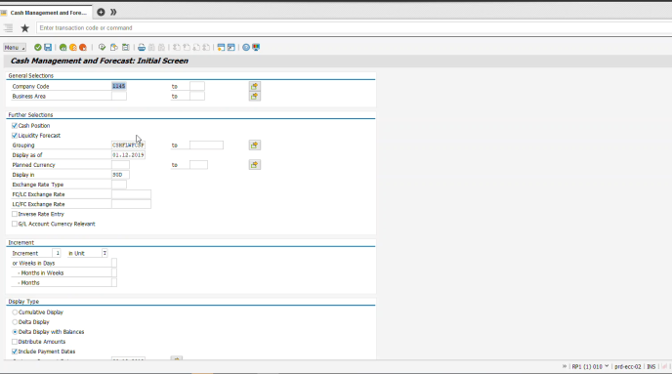
SAP Cash Flow Forecasting - DEMO

Slide 11

RPA – ROBotic process automation
3 Treasury processes identified → only 1 approved for implementation
Reason:
Cost/Benefit not according to the company standard
Process could be automated through standard SAP functionality (i.e. cash concentration)
Process too complex and too sensitive for errors (SAP, Download to XLS, Upload to SAP)

Slide 12
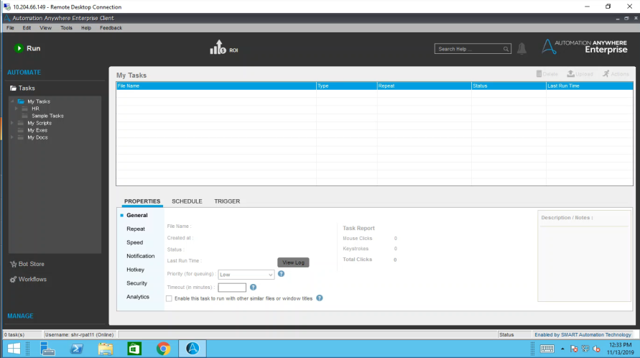

Slide 13
RPA – Most common challenges
Business Case Issues
Process has to be right
Complexity of the Bot
Skills of the implementation team
Cost consideration – RPA is expensive
Incorrect Solution for the process
Post-Implementation Adoption
RPA Maintenance
Audit Concerns

Slide 14

AI – artificial intelligence
SAP Cash Application to be implemented
→ Recognition rate for cash application to be improved from 60% to 95%
Project got delayed due to insufficient readiness of the application from SAP to implement. Will be implemented during upgrade to S4HANA.
Amgen forced to extend contract with HanseOrga for Autobank Upgrade
Conclusion: Not always beneficial to be a front runner, timing is important!

Slide 15
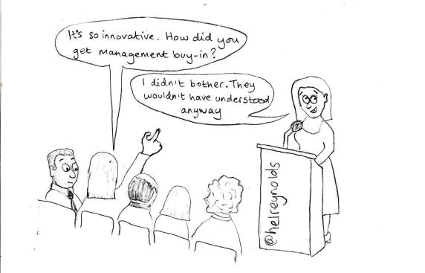
Funding and management buy-in
SAP implementations are costly and complex (I.E. BCM implementation costs around USD 300K)
Bots are expensive and maintenance as well (maintenance only is EUR 15K/year)
100% treasury employee involvement from start is key
How to get management buy-in for the funding and implementation of the project?
Implement a quick-win
Highlight (cost of manual error, possibility of fraud, employee motivation etc.)
Management (avoid future surprises)

Slide 16

Timing of implementation
Questions to answer:
Big bang or one process at the time?
Is it the right time to implement?
Is the technology ready today to meet our requirements?
Do we have enough FTE available for implementation?
How long will the implementation time be including unexpected error allowance?

Slide 17
WHO and what skill set is required
Design
Configuration/Architecture
IT teams
Define timeline
Testing
Problem Solving
Cutover Tasks Definition
Timeline Communication
Requirements
End Goal
Funding/Budget
User Look and Feel
End Product Approval
Final Demo
IT specialist
Treasury Specialist
Project Manager
Management Business User
IT specialist
Project Manager
Treasury System Specialist
IT specialist
Project Manager
Treasury System Specialist
Treasury Specialist
Management Business User

Slide 18
Key take aways
Management buy-in is key (quick wins and risk analysis for no transformation are helpful)
Sufficient funding and employee availability
Technology selection (involve system experts)
System/technology readiness to transform
Don’t underestimate implementation time

Slide 19

Thank you

