Slide 1
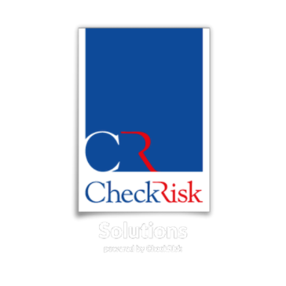
MANAGING COUNTERPARTY RISKS
& GENERATING REWARD IN AN END OF CYCLE ENVIRONMENT
2018 INNOVATION AWARD WINNER

Slide 2
AGENDA
Heightened uncertainty caused by end of cycle conditions is upon us.
it’s time to look at what might be different next time round and what you can do to PLAN FOR TOMORROW BY ACTING TODAY in understanding and managing your known and unknown risk exposures.
Current Economic Cycle & Market Conditions
McKinsey and Company, Global Banking Annual Review 2019: The last pit stop? Time for bold late-cycle moves
Achieving Positional Awareness: Distance to Distress and Networks
Examples

Slide 3
Key OutCOMES
Understand the importance of networks and positional awareness within them
Importance of looking beyond individual institutions to identify better Risk
How to spot early warnings of systemic change: positive and negative
Looking beyond traditional credit methodologies
How to generate reward from this RiskTech Approach

Slide 4
How cmoe yuor bairn is albe to
udnertsnad tihs snetnece even
tghouh olny the frist and lsat ltetres
of ecah wrod are crreoct ?

Slide 5
Current Economic & Market cycles
This is now the longest US economic expansion in history
The average since 1854 is 40 months
Previous record of 120 months of economic growth from March 1991 to March 2001
Now at 124 Months or 10 years 4 months
(National Bureau of Economic Research)
Credit Expansion Greatest in history since 2008 over $18 Trillion ($18 * 10¹²)
^{$18,000,000,000,000}

Slide 6
Market CYCLE
The current market boom started on 9 March 2009
Massive +468% gain for the S&P 500 until 1 November 2019 OR 128 MONTHS
Economic Growth Fears are rising: Trade Wars, Brexit, Inventory Cycles
Breaking Unconventional Monetary Policy = B.U.M.P.

Slide 7
MCKINSEY & COMPANY
“As growth slows, banks across the globe need to urgently consider
a suite of radical organic or inorganic moves before we hit a downturn”
Signs that the banking industry has entered the late phase of the economic cycle
Growth in volumes and top-line revenues is slowing
Loan growth of just 4% in 2018; lowest in the past five years & 150 basis points below nominal GDP growth
Yield curves are flattening
And, although valuations fluctuate, investor confidence in banks is weakening once again
Global return on tangible equity (ROTE) has flatlined at 10.5%
McKinsey & Company Global Banking Annual Review 2019:
The last pit stop? Time for bold late-cycle moves (October 2019)

Slide 8
MCKINSEY & COMPANY
Emerging market banks ROTEs have declined steeply; 20.0% in 2013 to 14.1% in 2018
Developed markets banks have strengthened productivity & managed risk costs; ROTE from 6.8% to 8.9%
BUT… nearly 60% of banks printing returns below the cost of equity
A prolonged economic slowdown with low or even negative interest rates could wreak further havoc
Up to 50% of banks could FAIL in the next economic downturn
McKinsey & Company Global Banking Annual Review 2019:
The last pit stop? Time for bold late-cycle moves

Slide 9
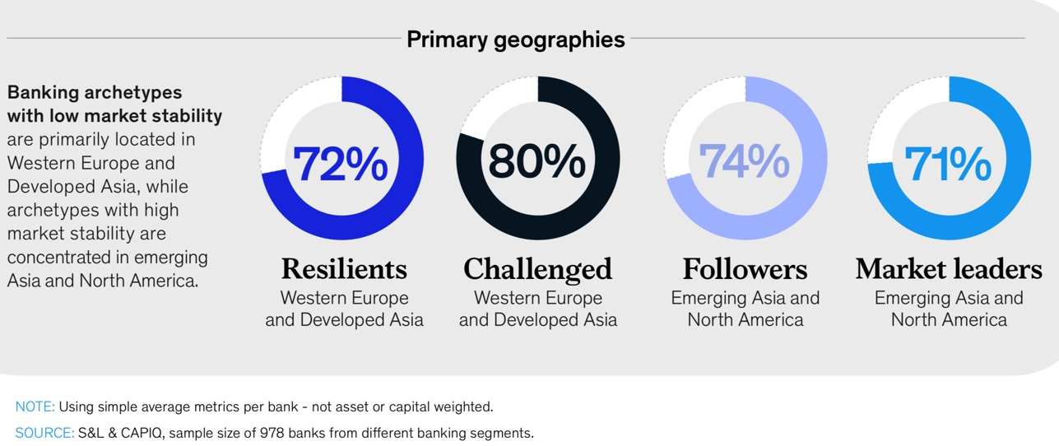
McKinsey & Company Global Banking Annual Review 2019:
The last pit stop? Time for bold late-cycle moves

Slide 10
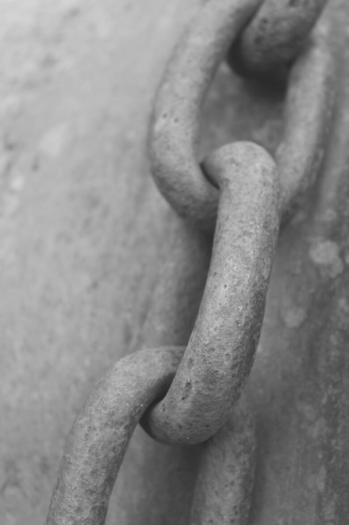
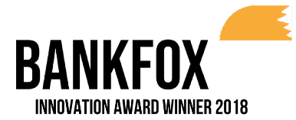
Traditional credit and counterparty risk tools give ratings but no insight into networks of risk and their impact on your business
Lehman’s crisis showed most institutions were unaware of their counterparty risk exposure… has anything really changed?
BankFox enables you to:
See & understand your known and unknown exposures
Optimise your portfolio to minimise risk (esp counterparty risk) & maximise return
Monitor the health of your portfolio of counterparty institutions
Monitor the health of the global financial system
how well do you really know your risk exposure?
-------------------
-------------------
Unicredit
-------------------
Traditional risk approaches, like credit scores and CDS spreads, focus on individual institutions.
TURKIYE
BANK ASI
-----------------------------------
BNP
-------------------
ING
--------------
------------------
-------------------
-------------------
BBVA
ME
-------------------
-------
-------------------
Network risk approaches, like BankFox, take into account both individual institutions but also their interrelationships revealing known & unknown risk exposures.
Barclays

Slide 11
“At this juncture, however, the impact on the broader economy and financial markets of the problems in the sub-prime market seems likely to be contained.”
Ben Bernanke, March 2008
Great Financial Crisis
BankFox provides a real time measure of the health of the American, European, Asian and Global financial system.
BankFox users would have seen that the GFC was not ‘contained’ in March 2008
The American Banking system did not recover for a long period after Lehman’s collapse.
“Given the fundamental factors in place that should support the demand for housing, we believe the effect of the troubles in the sub-prime sector on the broader housing market will likely be limited.”
Ben Bernanke, May 2007

Slide 12
Source: CheckRisk BankFox

Slide 13
Distance to DISTRESS
A MEASURE OF HOW FAR A BANK IS FROM THE NEED TO RECAPITALISE
Green for DtD>2.8, a 1 in 10000 chance of distress tomorrow
Yellow for DtD< 2.8 but DtD> 2.5, a 1 in 7500 chance of entering distress tomorrow
Then transitions gradually through orange to red
With Red being DtD<2, a 1 in 5000 chance of entering distress tomorrow.

Slide 14
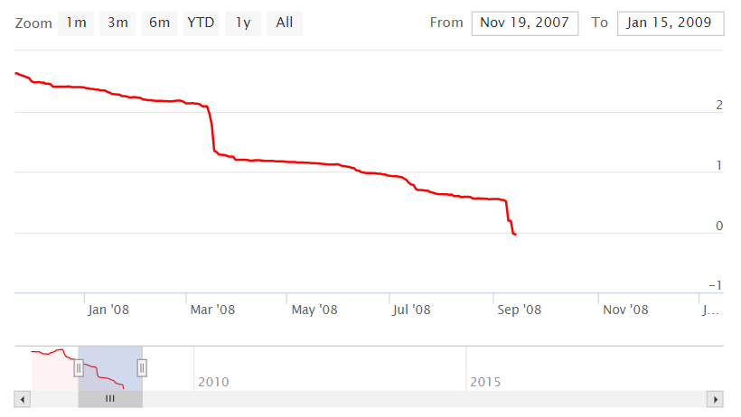
AnaTOMY OF A COLLAPSE
Source: CheckRisk BankFox

Slide 15
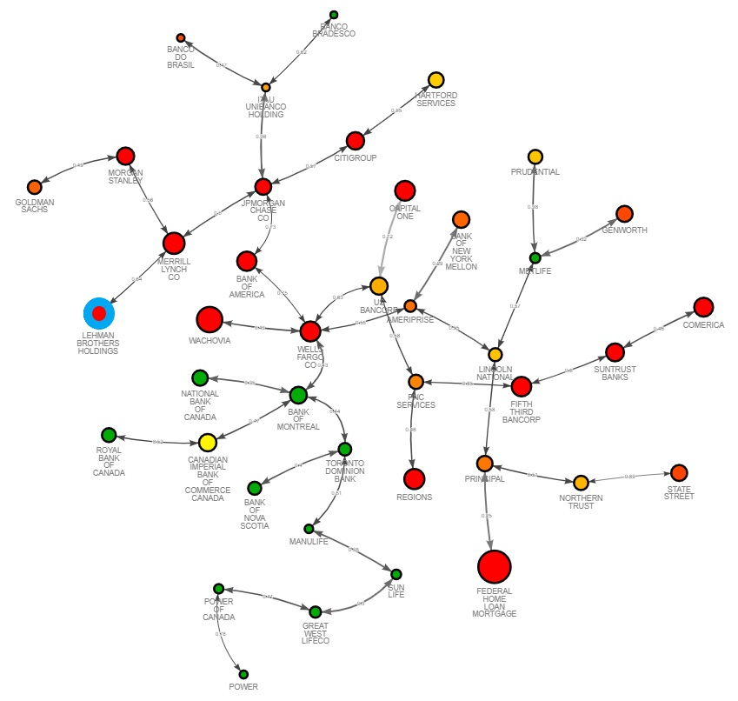
AnaTOMY OF BANK FAILURES
& NETWORK RISKS
Many Banks close to distress
Banks susceptible due to connections e.g. Lincoln, Bank of America
Canadian Banks are healthier, but network shows Toronto Dominion most susceptible to shocks from the US
Source: CheckRisk BankFox, November 2019

Slide 16
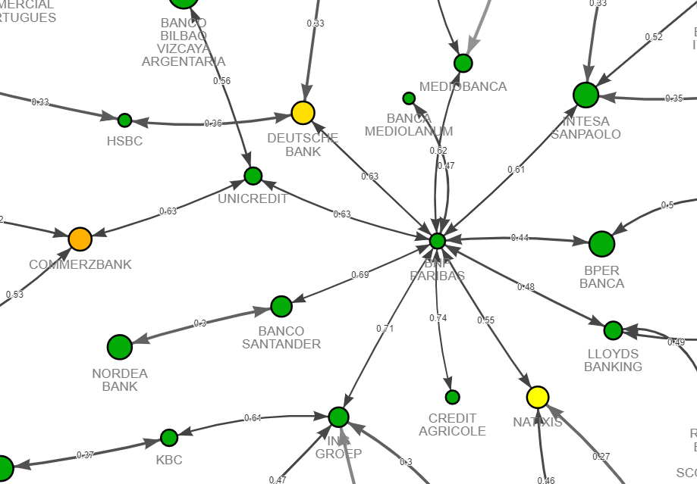
European Bank NEXUS
Deutsche Bank & Commerz Bank Systemically Important Banks
BNP Paribas forms a network focal point
Diversification in Europe is getting harder
Source: CheckRisk BankFox, November 2019

Slide 17
In Trouble Today?
Yellow for DtD< 2.8 but DtD> 2.5, a 1 in 7500 chance of entering distress tomorrow
Source: CheckRisk BankFox, November 2019

Slide 18
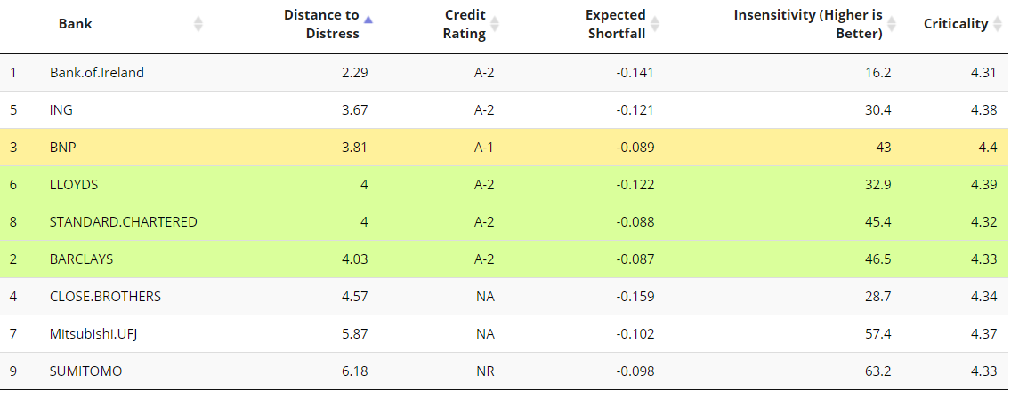
Generating a REWARD FROM RISKTECH
Source: CheckRisk BankFox

Slide 19
Plan for tomorrow, manage today
“. . . The best time to plant a tree was 20 years ago. The second-best time is now.”
Ancient Chinese Proverb
2018 INNOVATION AWARD WINNER

Slide 20
Nick Bullman
nick@check-risk.com 07788 422583

